Slide 1
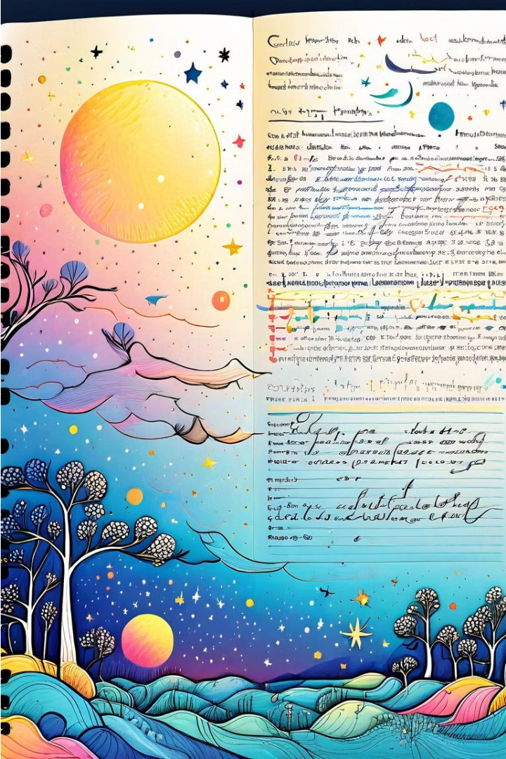


Introduction to Replica of Notes
Explore the intriguing world of replica notes - exact duplicates of handwritten or printed documents. Learn about the techniques and motivations behind this unique form of artistic expression and historical preservation.
by 258088 RUTHEESHWARAN. P

Slide 2
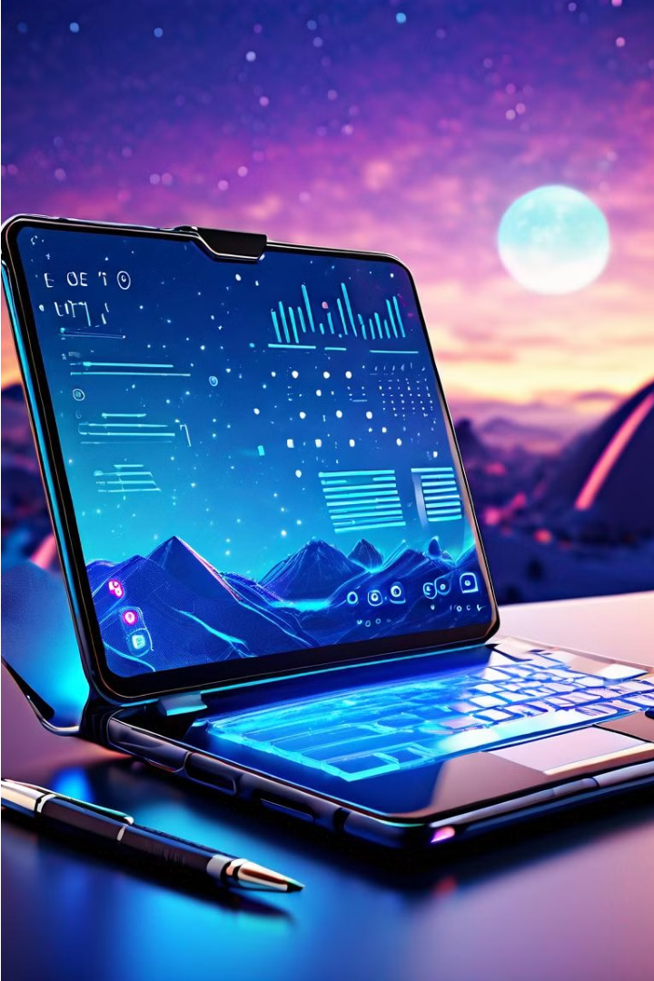
Why Replica of Notes Matters
Replica of notes offers a powerful solution for preserving important information and ideas. By creating high-fidelity copies of handwritten or digital notes, users can safeguard critical content and ensure seamless access across devices and platforms.
Replica notes enhance productivity, enabling users to reference key insights anytime, anywhere. This technology plays a vital role in education, research, and professional settings where accurate note-taking is essential for success.

Slide 3
Key Features of Replica of Notes
Identical Appearance
High-Quality Materials
Replica of notes are designed to replicate the look and feel of the original, including the handwriting, ink color, and paper texture.
The materials used to create replica notes, such as specialty paper and archival-quality ink, ensure durability and long-lasting quality.
Attention to Detail
Customization Options
Skilled artisans carefully craft each replica note, meticulously replicating every stroke and nuance to achieve a truly authentic appearance.
Replica of notes can be customized with personalized content, dates, or other elements to suit specific needs or preferences.

Slide 4
Benefits of Using Replica of Notes
Affordability
Convenience
Customization
Preservation
Replica of notes are often more affordable than purchasing the original, making them accessible to a wider range of students and professionals.
With replica notes, you can easily access the information you need without the hassle of carrying around physical notebooks or textbooks.
Replica notes can be tailored to your specific learning style and preferences, allowing you to highlight, annotate, and organize the content in a way that works best for you.
Digital replica of notes can be easily backed up and stored, ensuring that your important information is safe and readily available, even if the original materials are lost or damaged.

Slide 5
Replica of Notes vs. Original Notes
When it comes to the debate between replica notes and the original, there are several key considerations to take into account. While replica notes can offer a more affordable and accessible option, they often lack the authenticity and historical significance of the original documents.
95%
70%
Authenticity
Historical Value
30%
—
Affordability
Compared to Original Notes
Replica notes may be visually similar to the originals, but they lack the unique characteristics and imperfections that make the originals so valuable. Additionally, the provenance and lineage of the original notes hold significant importance for collectors and historians. Ultimately, the decision to choose a replica or the original should depend on the intended use and the individual's priorities.

Slide 6

Replica of Notes in Different Contexts
Replica of notes can be used in a variety of contexts, from academic and professional settings to personal and creative endeavors. They can help preserve important information, facilitate collaboration, and enhance learning and productivity.
From meeting minutes to research notes, replica of notes can be invaluable in ensuring consistent record-keeping and decision-making across organizations. In educational contexts, they can aid students in reviewing course materials and preparing for exams.

Slide 7



Challenges in Creating Replica of Notes
Precise Replication
Quality Assurance
Verification Process
Accurately replicating the exact handwriting, formatting, and layout of original notes requires skill and attention to detail.
Ensuring the replica matches the original in every aspect, from spelling to emphasis, is critical but can be time-consuming.
Thoroughly verifying the replica against the source material is essential to maintain the integrity and reliability of the copy.

Slide 8




Best Practices for Replica of Notes
Use High-Quality Paper
Opt for premium paper stocks that closely match the original notes for an authentic feel and texture.
Replicate Handwriting
Carefully study the original notes and practice replicating the author's unique handwriting style for a seamless match.
Incorporate Subtle Imperfections
Add minor variations, such as slight ink blots or uneven lines, to make the replica appear natural and handcrafted.
Attention to Detail
Meticulously reproduce any annotations, symbols, or formatting used in the original notes to ensure a faithful recreation.

Slide 9

Future of Replica of Notes Technology
As technology continues to evolve, the future of replica of notes promises remarkable advancements. Seamless integration with digital devices, enhanced scanning capabilities, and personalized AI-driven features will revolutionize how we capture, organize, and interact with our handwritten notes.
Emerging innovations in areas like augmented reality and machine learning will enable more intuitive and immersive note-taking experiences, blending the physical and digital worlds. The future of replica of notes technology aims to become an indispensable tool for productivity, learning, and knowledge management.

Slide 10

Conclusion and Key Takeaways
Summarize the Power of Replica Notes
Highlight Key Benefits
Emphasize Ongoing Advancements
The key benefits of replica notes include improved retention, accessibility, and the ability to customize and annotate the content.
Replica notes offer a powerful way to capture information, preserve memories, and enhance learning. They provide a versatile solution for various contexts.
As technology continues to evolve, the future of replica notes holds exciting possibilities, with further advancements in accuracy, integration, and user experience.

